Slide 1
Side-by-side by Design: Pharma Data Handling with Merge, Join, Match, and Hash in R
2025-11-04
Yutaka Morioka
Yuki Nakagawa
EPS corporation
morioka.yutaka038@eps.co.jp

Slide 2


Yutaka Morioka
Title: SAS Guru
Organization: EPS Corporation
A SAS programmer based in Japan and clinical data scientist. I actively disseminate SAS programming techniques from introductory to advanced levels and have presented at international and regional conferences including SAS Global Forum, CDISC Interchange Japan, Phuse Japan SDE, and PharmaSUG SDE. As an organizer of the SAS User’s Group in Japan, I also focus on fostering collaboration between SAS and R programmers, aiming to create synergy across both communities.
Yuki Nakagawa
Title: SAS Programmer / Biostatistician
Organization: EPS Corporation
Since joining the Statistical Analysis Department of EPS Corporation in 2019, Yuki Nakagawa has been engaged in clinical trials service from SDTM to statistical analyses as the SAS Programmer and biostatistician.

Slide 3
Disclaimer and Disclosures
The opinions expressed are those of the authors and do not necessarily reflect the official views or positions of their organizations.
This presentation introduces various approaches to data joining,
but it does not intend to determine or recommend a single “best” method.
The authors declare no conflicts of interest related to any of the methods, packages, or tools mentioned in this presentation.
In this presentation, I will limit the discussion to merging two tables due to time constraints.
The picture can change when merging three or more tables, but that will be for
another occasion.

Slide 4
Instruction

Slide 5

Instruction
In clinical trial data handling, data merging is arguably the most frequently used operation.
Especially in the derivation of SDTM and ADaM datasets, programmers often perform left joins using uniquely identifying keys such as USUBJID, SUBJID, VISIT, or TESTCD.However, few programmers take the time to re-examine what “joining” really means.
There are multiple ways to perform a join, each based on a different conceptual foundation. Moreover, the behavior of merge in SAS differs significantly from that in R, which often leads to confusion for programmers swiching from SAS to R.
Since misunderstanding how joins work can easily lead to unintended data errors, this presentation aims to take a deep and careful look at data joins from both a conceptual and practical perspective.

Slide 6
Base.R merge function

Slide 7
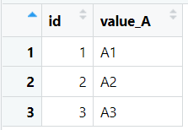
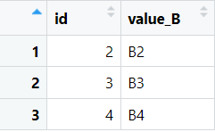
TEST data - Base.R merge
# DataFrame 11
df11 <- data.frame(
id = c(1, 2, 3),
value_A = c("A1", "A2", "A3"))
# DataFrame 12
df12 <- data.frame(
id = c(2, 3, 4),
value_B = c("B2", "B3", "B4"))

Slide 8
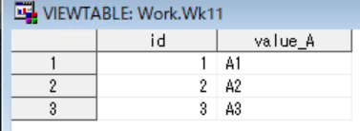
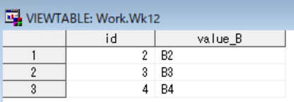
TEST data(SAS dataset) -- Base.R merge
data wk11;
do id = 1 , 2, 3;
value_A = choosec(id,"A1","A2","A3");
output;
end;
run;
data wk12;
do id = 2, 3, 4;
value_B = choosec(id-1,"B2","B3","B4");
output;
end;
run;

Slide 9
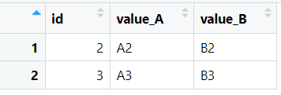
Inner Join - Base.R merge
inner_joined <- merge(df11, df12, by = "id")

Slide 10
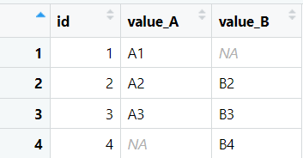
Full Outer Join - Base.R merge
full_outer_joined <- merge(df11, df12, by = "id", all = TRUE)

Slide 11
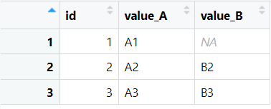
Left Outer Join - Base.R merge
left_joined <- merge(df11, df12, by = "id", all.x = TRUE)

Slide 12
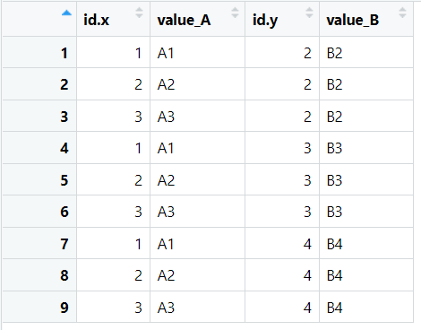
Cross Join - Base.R merge
cross_joined <- merge(df11, df12, by = character())

Slide 13
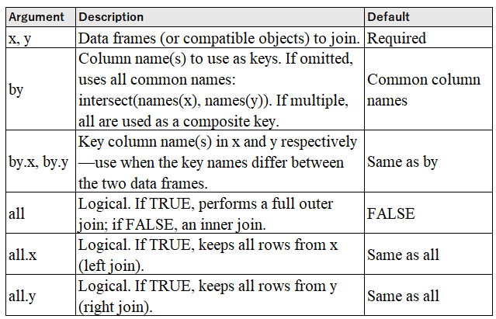
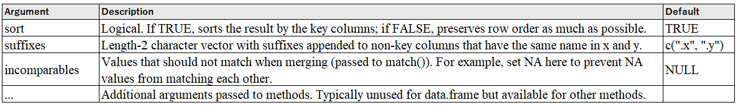
Base.R merge
merge(x, y,
by = intersect(names(x), names(y)),
by.x = by, by.y = by,
all = FALSE,
all.x = all, all.y = all,
sort = TRUE,
suffixes = c(".x", ".y"),
incomparables = NULL,
...)

Slide 14
SAS Merge

Slide 15
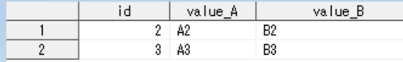
SAS merge – Inner Join
proc sort data=wk11;
by id;
run;
proc sort data=wk12;
by id;
run;
data inner_join;
merge wk11(in=in11)
wk12(in=in22);
by id;
if in11 and in22;
run;

Slide 16
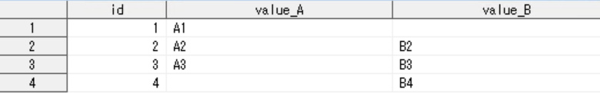
SAS merge – Full Outer Join
proc sort data=wk11;
by id;
run;
proc sort data=wk12;
by id;
run;
data outer_join;
merge wk11
wk12;
by id;
run;

Slide 17
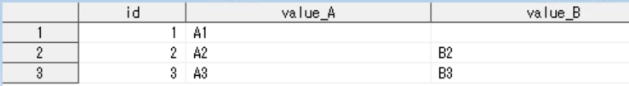
SAS merge – Left Outer Join
proc sort data=wk11;
by id;
run;
proc sort data=wk12;
by id;
run;
data left_outer_join;
merge wk11(in=in11)
wk12(in=in22);
by id;
if in11;
run;

Slide 18
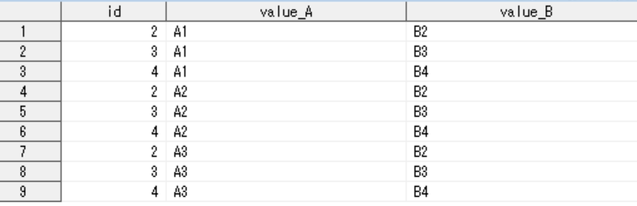
SAS – Cross Join
data cross_join;
set wk11;
do i=1 to wk12obs;
set wk12 nobs=wk12obs point=i;
output;
end;
run;

Slide 19
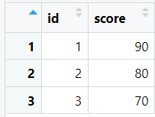
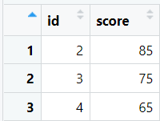
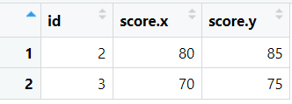
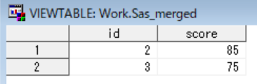
R.Base merge VS SAS merge
data wk21;
do id = 1 , 2, 3;
score= choosen(id,90,80,70);
output;
end;
run;
data wk22;
do id = 2, 3, 4;
score = choosen(id-1,85,75,65);
output;
end;
run;
proc sort data=wk21;
by id;
run;
proc sort data=wk22;
by id;
run;
data sas_merged;
merge wk21(in=in11)
wk22(in=in22);
by id;
if in11 and in22;
run;
df21 <- data.frame(
id = c(1, 2, 3),
score = c(90, 80, 70)
)
df22 <- data.frame(
id = c(2, 3, 4),
score = c(85, 75, 65)
)
merged <- merge(df21, df22, by = "id")

Slide 20
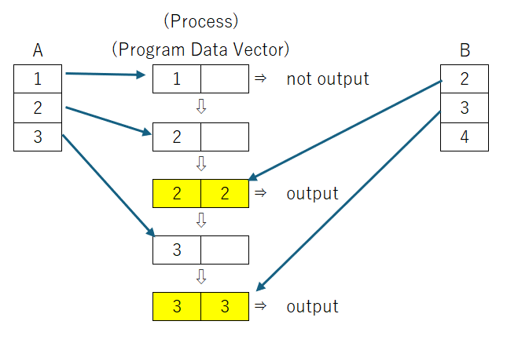
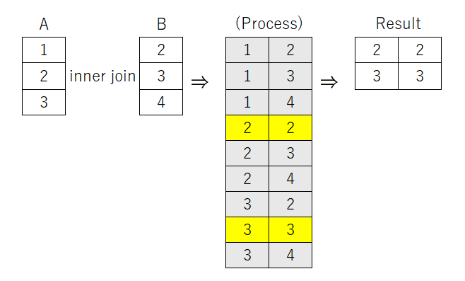
Concepts of Internal Processing in SAS and R
R.merge Function SQL Join
SAS
“Sequential processing” refers to the concept of implicitly looping through all records by reading one record, processing it, and then outputting one record — repeating this sequence for every record.

Slide 21
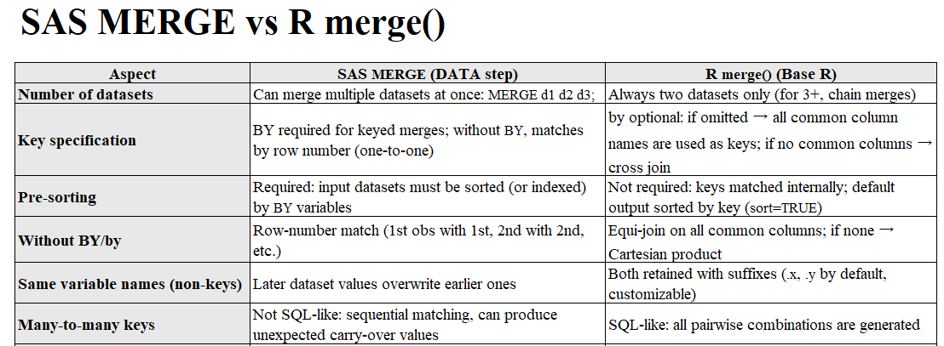

Slide 22
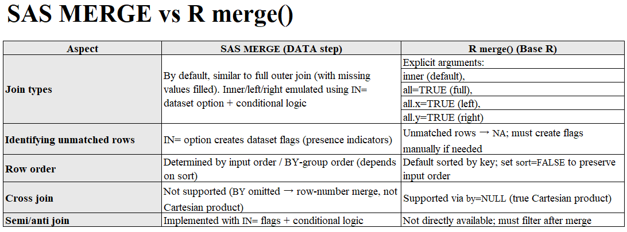

Slide 23
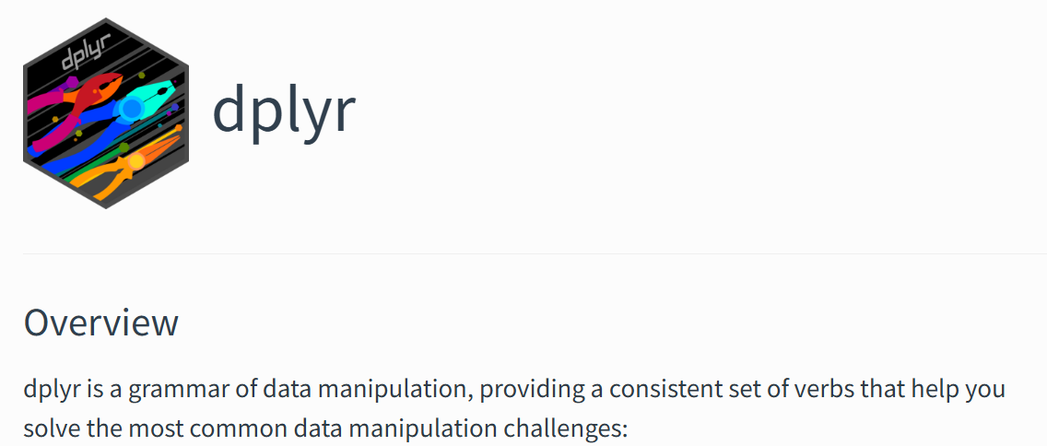
dplyr
https://dplyr.tidyverse.org/

Slide 24
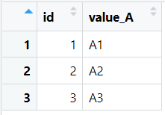
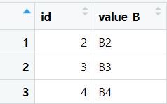
Test data – dplyr
library(dplyr)
df31 <- tibble(
id = c(1, 2, 3),
value_A = c("A1", "A2", "A3")
)
df32 <- tibble(
id = c(2, 3, 4),
value_B = c("B2", "B3", "B4")
)

Slide 25
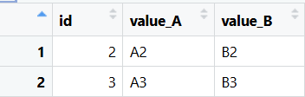
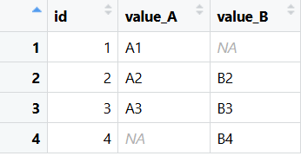
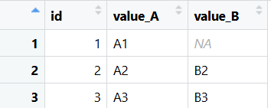
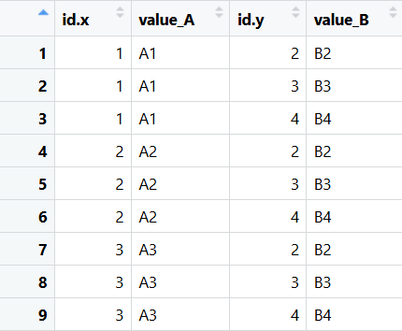
Join – dplyr
inner_join <- inner_join(df31, df32, by = "id")
full_join <- full_join(df31, df32, by = "id")
left_join <- left_join(df31, df32, by = "id")
cross_join <- cross_join(df31, df32)
#Cross Join (Before dplyr v1.1.0)
cross_join2 <- df31 %>%
mutate(dummy = 1) %>%
inner_join(df32 %>% mutate(dummy = 1), by = "dummy") %>%
select(-dummy)

Slide 26
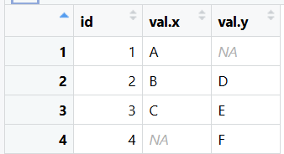
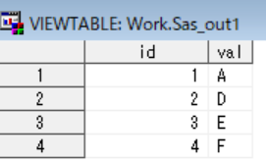
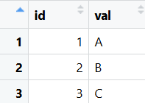
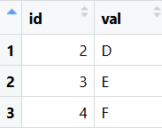
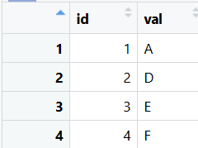
dplyr:full_join ≠ SAS merge
data sas_out1 ;
merge wk1 wk2;
by id;
run;
library(dplyr)
wk1 <- tibble(id = 1:3, val = c("A", "B", "C"))
wk2 <- tibble(id = 2:4, val = c("D", "E", "F"))
out1 <- full_join(wk1, wk2, by = "id")
dplyr:full_join ≠ SAS merge
out2 <- rows_upsert(wk1, wk2, by = "id")
In this case, `rows_upsert` behaves similarly to a SAS merge rather than a full join.

Slide 27
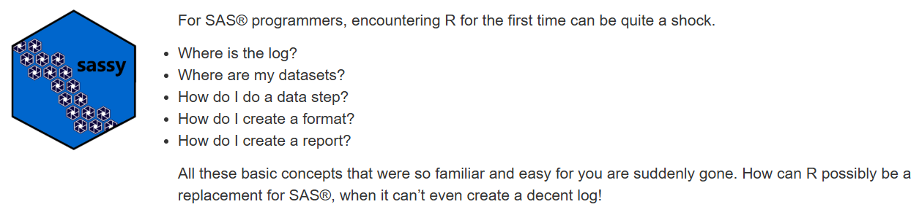
sassy
https://sassy.r-sassy.org/index.html

Slide 28
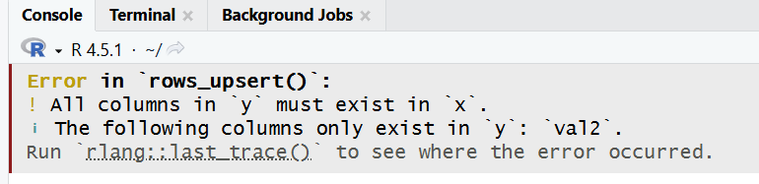
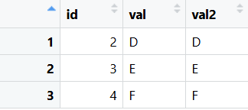
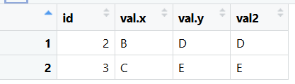

sassy – merge
wk1 <- tibble(id = 1:3, val = c("A", "B", "C"))
wk3 <- tibble(id = 2:4, val = c("D", "E", "F"),val2 = c("D", "E", "F") )
out3 <- rows_upsert(wk1, wk3, by = "id")
library(sassy)
out4 <- datastep(
merge(wk1, wk3, by = "id", type = "full"),
{}
)
Even when using the sassy package to replicate SAS behavior in R, it does not fully replicate the merge statement.

Slide 29
“Perfect replication” is difficult because the SAS merge ... by ...; relies on a unique execution model:
PDV (Program Data Vector): values from the other dataset are retained and carried forward.
Sequential matching within BY groups: duplicates are matched in order, not as a SQL-style Cartesian join.
Overwriting of same-named variables: variables from later datasets overwrite earlier ones, while at the same time special flags like IN=, FIRST., and LAST. are available.

Slide 30
SQL

Slide 31
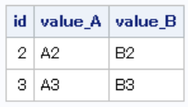
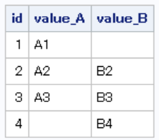
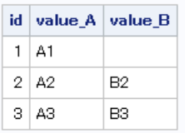
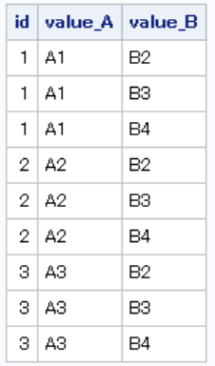
SQL – Join
/*Inner join*/
select coalesce(wk11.id, wk12.id) as id
,value_A
, value_B
from wk11 inner join wk12 on wk11.id = wk12.id;
/*full outer join*/
select coalesce(wk11.id, wk12.id) as id
,value_A
, value_B
from wk11 full outer join wk12 on wk11.id = wk12.id;
/*left outer join*/
select coalesce(wk11.id, wk12.id) as id
,value_A
, value_B
from wk11 left outer join wk12 on wk11.id = wk12.id;
/*cross join*/
select coalesce(wk11.id, wk12.id) as id
,value_A
, value_B
from wk11 cross join wk12 ;

Slide 32
Various Ways to Implement SQL in R
library(sqldf)
sqldf <- sqldf("SELECT a.id, a.value_A, b.value_B
FROM df11 a
INNER JOIN df12 b
ON a.id = b.id")
1. sqldf packageThe most well-known methodAllows direct handling of dataframes with SQLUses SQLite internally for processing
library(DBI)
library(RSQLite)
con <- dbConnect(RSQLite::SQLite(), ":memory:")
dbWriteTable(con, "df11", df11)
dbWriteTable(con, "df12", df12)
dbi1 <- dbGetQuery(con, "SELECT a.id, a.value_A, b.value_B
FROM df11 a
INNER JOIN df12 b
ON a.id = b.id")
2. DBI + dplyr/dbplyrCombining R's database connection API (DBI) with dbplyr—an extension of dplyr—enables you to convert dplyr code into SQL for execution on databases.Furthermore, using DBI::dbGetQuery() allows you to write raw SQL directly.
library(duckdb)
con <- dbConnect(duckdb())
dbWriteTable(con, "df11", df11)
dbWriteTable(con, "df12", df12)
duckdb <- dbGetQuery(con, "SELECT a.id, a.value_A, b.value_B
FROM df11 a
INNER JOIN df12 b
ON a.id = b.id")
3. duckdb PackageUse DuckDB, an ultra-fast embedded DB engine, in RRun SQL queries directly on dataframesIt's becoming a staple for large-scale data processing

Slide 33
Base.R match

Slide 34
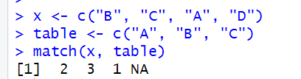
Base.R match
The match function compares vectors and returns an index.
x <- c("B", "C", "A", "D")
table <- c("A", "B", "C")
match(x, table)

Slide 35
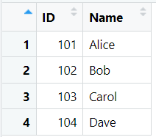
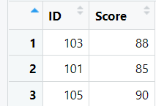
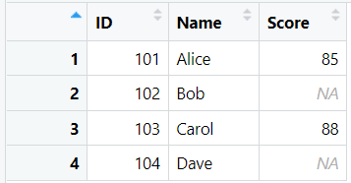
Base.R match
df41 <- data.frame(
ID = c(101, 102, 103, 104),
Name = c("Alice", "Bob", "Carol", "Dave")
)
df42 <- data.frame(
ID = c(103, 101, 105),
Score = c(88, 85, 90)
)
match <- df41
match$Score <- df42$Score[ match(df41$ID, df42$ID) ]
In short, match() is a “position-return” type join method a simplified version of SQL JOIN (limited to many-to-one, left joins)useful for fetching values in a lookup-like manner.

Slide 36
hash
https://cran.r-project.org/web/packages/hash/index.html

Slide 37
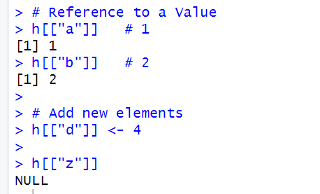
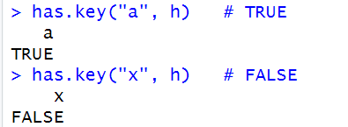
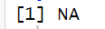
hash
library(hash)
# Creating a Hash
h <- hash(keys = c("a", "b", "c"), values = c(1, 2, 3))
# Reference to a Value
h[["a"]] # 1
h[["b"]] # 2
# Add new elements
h[["d"]] <- 4
h[["z"]]
Key
Data
# Existence check with has.key()
has.key("a", h) # TRUE
has.key("x", h) # FALSE
# Safe lookup: return NA if not exist
k <- "x"
if (has.key(k, h)) {
print(h[[k]])
} else {
print(NA)
}

Slide 38
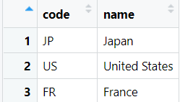

hash
# Lookup Table（Country Code, Country Name）
lookup <- data.frame(
code = c("JP", "US", "FR"),
name = c("Japan", "United States", "France")
)
# Target Dataset
df <- data.frame(
subject = 1:5,
code = c("JP", "US", "CN", "FR", "JP")
)

Slide 39

hash
library(hash)
# Create Hash
h <- hash(keys = lookup$code, values = lookup$name)
df$name <- vapply(df$code,
function(k) if (has.key(k, h)) h[[k]] else NA_character_,
FUN.VALUE = character(1))

Slide 40
hash
Summary of the R hash package
Fundamentally, it is a dictionary structure of “one key → one value.”
While the value can be a vector or a list, it is not natural to define multiple variables as keys or to manage multiple variables together as data.
Therefore, unlike the SAS hash object, it does not support something like defineKey / defineData method with multiple variables.
Intuitively, its behavior is closer to a proc format lookup table in SAS (mapping a code to a label).

Slide 41

data.table
https://github.com/Rdatatable/data.table?tab=readme-ov-file

Slide 42
data.table
Key Features of data.table in R
High Performance
Extremely fast operations even with tens of millions of rows.
Optimized algorithms for joins and aggregation.
Reference-based operations minimize memory consumption.
Concise Syntax ([i, j, by])
Core structure: DT[i, j, by]
i: row filtering (similar to SQL WHERE)
j: column operations or aggregations (similar to SQL SELECT)
by: grouping (similar to SQL GROUP BY)
Enables SQL-like data manipulation in a very compact form.
Flexible and Fast Joins
Key-based joins with on= are highly efficient.
Supports equi-joins, non-equi joins, rolling joins, and multi-key joins.
Can reproduce INNER, LEFT, and FULL OUTER JOIN behavior.

Slide 43


data.table
library(data.table)
dt51 <- data.table(id = c(1,2,3), val1 = c("A","B","C"))
dt52 <- data.table(id = c(2,3,4), val2 = c(10,20,30))

Slide 44


Inner & Left Outer Join - data.table
#Inner Join
dt_out1 <- dt51[dt52, on = .(id), nomatch=0]
#Left Outer Join (dt51 on the left side as the reference)
dt_out2 <- dt52[dt51, on = .(id)]

Slide 45


Full Outer & Cross Join - data.table
#Full Outer Join
dt_out3 <- merge(dt51, dt52, by="id", all=TRUE)
data.table::merge.data.table(dt51, dt52, by = "id", all = TRUE)
#Cross Join
dt51_ <- dt51[, key := 1]
dt52_ <- dt52[, key := 1]
dt_out4 <- dt51_[dt52_, on=.(key)
, allow.cartesian=TRUE][, key := NULL]

Slide 46



Rolling Join - data.table
#Rolling Join
dt_query <- data.table(time = c(2,6,9))
dt_time <- data.table(time = c(1,5,10)
, value = c("a","b","c"))
#Join the most recent past value
dt_out5 <- dt_time[dt_query, on=.(time), roll=TRUE]

Slide 47
Rolling Join - data.table
Rolling join is an ordered join that fills in matches using the closest previous (or next) key value, when an exact match is not found.
For each value in the query table, find the closest matching key in the source table that does not exceed it (when roll=TRUE).
In data.table's Rolling Join, when there are duplicate key values,the row that is matched depends on the mult argument:by default, the first matching row is used (mult = "first"),while setting mult = "last" makes it use the last one.
Option | Description
roll = TRUE | Carry the most recent past value forward (LOCF)
roll = Inf | Carry the most recent past value forward (LOCF)
roll = -Inf | Carry the next future value backward (NOCB)
roll = "nearest" | Use whichever value is closest (past or future)

Slide 48



Non-equi Join - data.table
# Non-equi Join (point-in-interval join)
dt_range <- data.table(start = c(1,5), end = c(3,10), label=c("low","high"))
dt_point <- data.table(x = 1:10)
# Combine elements where x is within the range start <= x <= end
dt_out6 <- dt_range[dt_point, on=.(start <= x, end >= x), nomatch=0]

Slide 49



Non-equi Join - data.table
# Non-equi Join
# Get the nearest previous or next value (without rolling)
X <- data.table(time = c(1, 5, 10), value = c("a", "b", "c"))
Y <- data.table(time = c(2, 6, 9))
setkey(X, time)
# Nearest previous (time < y)
prev <- X[Y, on = .(time < time), mult = "last"]

Slide 50




Non-equi Join - data.table
# Non-equi Join
#Matching within a +-tolerance band
#Use non-equi conditions to find all matches inside [u − tol, u + tol],
#then pick the closest one (dist = abs(t − u)).
# Match within the tolerance band
X <- data.table(id=1, t=c(1,5,9,12), val=c("A","B","C","D"))
Y <- data.table(id=1, u=c(2,6,11), tol=c(2,1,3))
setkey(X, id, t)
# Precompute join columns
Y[, lower := u - tol]
Y[, upper := u + tol]
# Now perform the join safely
hits <- X[Y, on = .(id, t >= lower, t <= upper),
nomatch=0,.(id, u, tol, t, val, dist = abs(t - u))]
# Keep only the closest match per (id,u)
nearest <- hits[order(id, u, dist)][, .SD[1], by=.(id, u)]

Slide 51
data.table vs. dplyr
Aspect | dplyr::inner_join | data.table [i, on=]
Conceptual Model | SQL-like (declarative) | Hash / index-based (imperative)
Implementation Algorithm | Hash-based (implemented in C++) not sorted. | Hash join or key-based binary search
Execution Environment | R + C++ (vctrs, dplyr) | C (datatable.c)
Key Features | Readability, strict type consistency, tidyverse integration | High speed, low memory usage, supports non-equi joins
Database Integration | Translated to SQL via dbplyr | In-memory only (no direct SQL translation)

Slide 52


PharmaForest (SAS)
https://pharmaforest.github.io/

Slide 53


Clinical Trial Data Handling
In clinical trial data programming, particularly in the creation of CDISC-compliant SDTM and ADaM datasets, left joins account for the vast majority of data merge operations.Moreover, in ADaM dataset derivations, it is extremely common to create flag variables (e.g., “Y/N”) indicating whether a given key variable such as USUBJID exists in another dataset.

Slide 54





PharmaForest
https://github.com/PharmaForest

Slide 55



%kvlookup - Sashash Package
data dm;
length SUBJID SEX $20.;
SUBJID="A001";SEX="MALE";AGE=14;output;
SUBJID="A002";SEX="FEMALE";AGE=13;output;
SUBJID="B001";SEX="MALE";AGE=13;output;
run;
data wk1;
length SUBJID $20.;
SUBJID="A001";output;
SUBJID="A002";output;
SUBJID="A003";output;
SUBJID="B001";output;
run;
data out1;
set wk1;
%kvlookup(master=dm,key=SUBJID,var=SEX AGE);
run;

Slide 56
Kvlookup_dt [R]
kvlookup_dt <- function(x,
master,
key, # character vector: key column names
var = NULL, # character vector: variable names to retrieve (NULL = all columns except keys)
wh = NULL, # character scalar: data.table expression applied to master (e.g., quote(Age > 12) or "Age > 12")
warn = FALSE, # whether to issue a warning when lookup keys are not found
overwrite = TRUE # whether to overwrite existing columns in x if names overlap
) {
stopifnot(requireNamespace("data.table", quietly = TRUE))
DTx <- data.table::as.data.table(x)
DTm <- data.table::as.data.table(master)
# --- Apply WHERE filter (wh) to master ---
if (!is.null(wh) && nzchar(as.character(wh))) {
# Allow both character and expression inputs for evaluation
if (is.character(wh)) {
wh_expr <- parse(text = wh)[[1]]
} else {
wh_expr <- wh
}
DTm <- DTm[eval(wh_expr)]
}
# --- Determine columns to keep (key + var) ---
if (is.null(var)) {
# If var is not specified, use all columns in master except keys
var <- setdiff(names(DTm), key)
}
keep_cols <- unique(c(key, var))
miss_cols <- setdiff(keep_cols, names(DTm))
if (length(miss_cols)) {
stop(sprintf("The following columns do not exist in master: %s", paste(miss_cols, collapse = ", ")))
}
DTm <- DTm[, ..keep_cols]
# --- Issue warnings (warn=TRUE when keys are non-NA but not found) ---
if (isTRUE(warn)) {
# "matched" = whether the master-side flag is TRUE
matched <- isTRUE(RES[[hit_col]])
matched[is.na(matched)] <- FALSE
# "key_any_present" = at least one key is non-missing
key_df <- RES[, ..key]
key_any_present <- apply(!is.na(as.data.frame(key_df)), 1, any)
not_found <- (!matched) & key_any_present
if (any(not_found)) {
# Log the missing key values
msg_keys <- apply(as.data.frame(key_df[not_found]), 1, function(rw) {
paste(sprintf("%s=%s", names(key_df), ifelse(is.na(rw),
"NA", as.character(rw))), collapse = ", ")
})
warning(sprintf("kvlookup_dt: %d key(s) not found in master. Examples:\n%s",
sum(not_found),
paste(utils::head(msg_keys, 5), collapse = "\n")))
}
}
# --- Remove temporary working column ---
RES[, (hit_col) := NULL]
# The result is a data.table where var columns are added to x
return(DTx[])
}
# --- Add a matching flag to master (used to check hits after join) ---
hit_col <- "__kv_hit__"
while (hit_col %in% names(DTm)) hit_col <- paste0(hit_col, "_")
DTm[, (hit_col) := TRUE]
# --- Set key for faster join ---
data.table::setkeyv(DTm, key)
# --- Perform join (X[i] form; keep i = x to preserve its order and row count) ---
# master[x, on=key] → keeps the number and order of i (=x) rows,
# with X (=master) columns first
RES <- DTm[DTx, on = key]
# --- Extract target columns (var) and merge them into x ---
# Handle name conflicts
dup_in_x <- intersect(var, names(DTx))
if (length(dup_in_x) && !overwrite) {
stop(sprintf("The following columns already exist in x (overwrite=FALSE): %s",
paste(dup_in_x, collapse = ", ")))
}
# Add new columns or overwrite existing ones (similar to SAS DATA step behavior)
for (vn in var) {
DTx[, (vn) := RES[[vn]]]
}
Using data.table, I reproduced the behavior of SAS’s PharmaForest.sashash Package. kvlookup macro — one of the most commonly used data-handling techniques in clinical trial programming — with equivalent functionality in R.

Slide 57



Kvlookup_dt [R]
dm <- data.table(SUBJID = c("A001","A002","B001"),
AGE = c(14,13,13),
SEX = c("MALE","FEMALE","FEMALE"))
wk1 <- data.table(SUBJID = c("A001","A002","A003","B001"))
out <- kvlookup_dt(
wk1, dm,
key = "SUBJID",
var = c("AGE","SEX")
)

Slide 58



Keycheck_dt [R]
It was also quite straightforward to reproduce the behavior of SAS’s %keycheck() macro using data.table in R.
keycheck_dt <- function(x,
master,
key, # character vector: key column names
wh = NULL, # character or expression: filter applied to master (e.g., "AGE >= 15")
fl = "exist_fl", # name of output flag column
cat = c("YN","NUM","Y") # "YN"=Y/N, "NUM"=1/0, "Y"=Y/""
) {
stopifnot(requireNamespace("data.table", quietly = TRUE))
cat <- match.arg(cat)
DTx <- data.table::as.data.table(x)
DTm <- data.table::as.data.table(master)
# --- apply WHERE filter (wh) on master ---
if (!is.null(wh) && nzchar(as.character(wh))) {
wh_expr <- if (is.character(wh)) parse(text = wh)[[1]] else wh
DTm <- DTm[eval(wh_expr)]
}
# --- keep only key columns, unique keys are enough for existence check ---
miss_cols <- setdiff(key, names(DTm))
if (length(miss_cols)) {
stop(sprintf("Columns not found in master: %s", paste(miss_cols, collapse = ", ")))
}
DTm <- unique(DTm[, ..key])
# --- prepare master with a hit flag for join result ---
hit_col <- "__key_hit__"
while (hit_col %in% names(DTm)) hit_col <- paste0(hit_col, "_")
DTm[, (hit_col) := TRUE]
# --- set keys for fast join ---
data.table::setkeyv(DTm, key)
# --- left-join-like existence check against x (preserve x's order/rows) ---
RES <- DTm[DTx, on = key]
# FIX: vectorized match flag
matched <- RES[[hit_col]] # logical vector: TRUE or NA
matched[is.na(matched)] <- FALSE # NA -> FALSE
# --- build the requested flag column on DTx ---
if (cat == "YN") {
DTx[, (fl) := ifelse(matched, "Y", "N")]
} else if (cat == "NUM") {
DTx[, (fl) := as.integer(matched)] # 1 if exists, 0 otherwise
} else if (cat == "Y") {
DTx[, (fl) := ifelse(matched, "Y", "")]
}
invisible(DTx[])
}
ae <- data.table(USUBJID = c("A001","A001","A003"),
AETERM = c("AE 1", "AE 2", "AE 1"))
dm <- data.table(USUBJID = c("A001","A002","A003","A004"))
out1 <- keycheck_dt(dm, ae, key="USUBJID", fl="AEFL", cat="YN")

Slide 59



Pharmaverse
https://pharmaverse.org/

Slide 60



Representative join-related functions in the {admiral} package

Slide 61



Representative join-related functions in the {admiral} package
derive_vars_merged()
library(admiral)
adae <- tibble(USUBJID = c("A001","A001","A003"),
AETERM = c("AE 1", "AE 2", "AE 1"))
adsl <- tibble(
USUBJID = c("A001","A002","A003","A004"),
TRTSDT = as.IDate(c("2024-01-10","2024-01-12","2024-01-15","2024-01-18"))
)
adae_1 <- derive_vars_merged(
dataset = adae,
dataset_add = adsl,
by_vars = exprs(USUBJID),
new_vars = exprs(TRTSDT)
)

Slide 62

Representative join-related functions in the {admiral} package
derive_var_merged_exist_flag()
adsl_1 <- derive_var_merged_exist_flag(
dataset = adsl,
dataset_add = adae,
by_vars = exprs(USUBJID),
condition = TRUE,
new_var = AEFL,
true_value = "Y",
false_value = "N" ,
missing_value= "N"
)

Slide 63



Pharmaforest {Adamski} package
In the current PharmaForest adamski package project,we are gradually working on reproducing the functionality of pharmaverse’s admiral in SAS,inspired by the concepts and design of admiral.

Slide 64



sdtm.oak

Slide 65
Final Comparison and Summary

Slide 66
Summary Notes
Common but Subtle Differences in Join Behavior Across R Frameworks
Aspect | base::merge | dplyr::left_join | data.table X[i, on=] | hash package
Default Sorting | Yes (sort=TRUE) | No (preserves left table order) | Preserves order of i (right operand) | Not applicable
Non-equi Join | Not supported | Not supported | Supported (on=.(a <= b, ...)) | Not applicable
Rolling / Nearest Join | Not supported | Not supported | Supported (roll=TRUE / mult) | Not applicable
Column Name Conflicts | Managed via suffixes | Appends .x / .y | Explicit reference with i. (overwrite using :=) | Not applicable
Many-to-Many Handling | Expands all combinations | Expands all combinations | Expands all combinations (requires unique() / aggregation if undesired) | Assumes one-to-one mapping
Performance on Large Data | △ Slow | △–○ Moderate (can leverage databases via dbplyr) | ◎ Excellent (in-memory optimized) | ○ Good (limited by single-key design)

Slide 67
Summary Notes
base::merge() is simple and reliable but can reorder rows and is memory-heavy.
dplyr::xxxx_join() emphasizes readability and consistency, suitable for tidy workflows and moderate datasets.
data.table joins are the most efficient and flexible, supporting non-equi and rolling logic ideal for clinical data (e.g., SDTM/ADaM period merges).
The hash package provides ultra-fast one-to-one lookups, best for code mapping or format-like replacements.
In CDISC workflows, it is also recommended to use the built-in join functions provided by Admiral or oak, as they help standardize and simplify data merge management across ADaM and SDTM process

Slide 68

I’m still learning R, so there might be a few mistakes in my slides.I’ll post any updates or corrections on GitHub or LinkedIn later.If you have any questions or comments, please feel free to contact me there.
[mail]
morioka.yutaka038@eps.co.jp
[Github]
https://github.com/Morioka-Yutaka
[Linkdin]
morioka 森岡 yutaka 裕

Slide 69

The above kanji is a motto of a professional Shogi (Japanese chess) player,meaning
“Always try a new move.”
I’ve long been passionate about pioneering new techniques in SAS, and now, I’m ready to do the same with R.

